Slide 1
Summary of the 3rd global ministerial conference on road safety

Slide 2


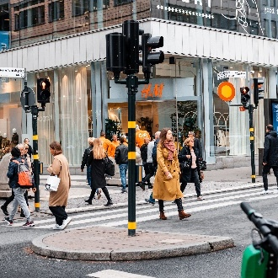
Borderless traffic
safety research
- setting the plan towards 2030
How can we in the research community together
utilize the opportunities that come with the
UN Conference and the Stockholm Declaration?
WEBINAR: The outcome of the UN Conference on road safety and the Stockholm declaration
TIME: May 6, 2020 12:00-13:15

Slide 3
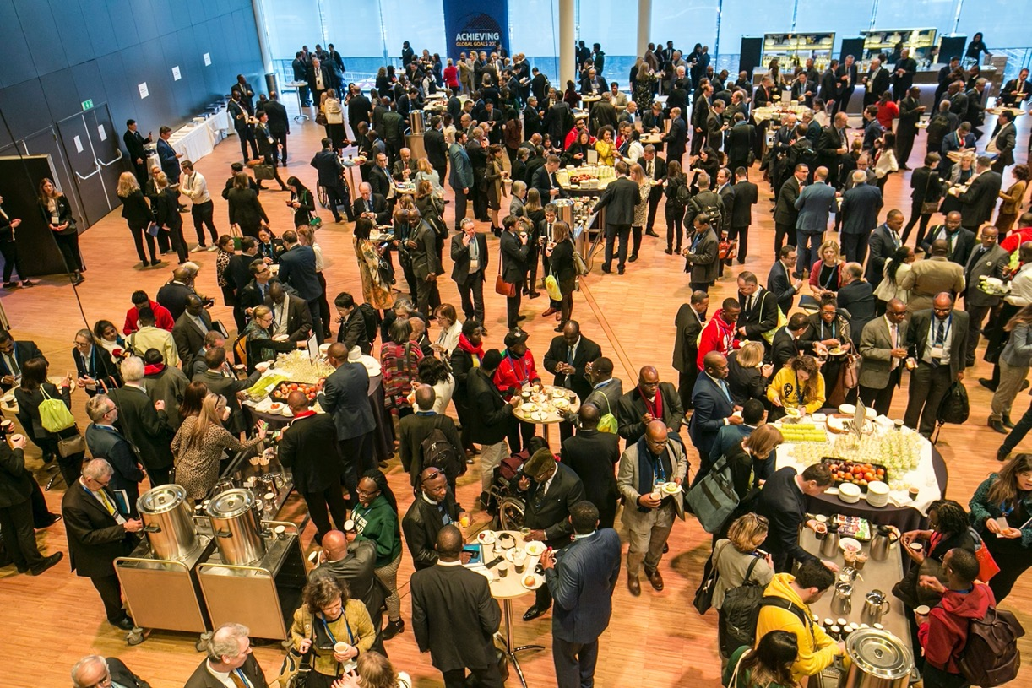
1558 Delegates
58 Minister-led delegations
119 Countries

Slide 4
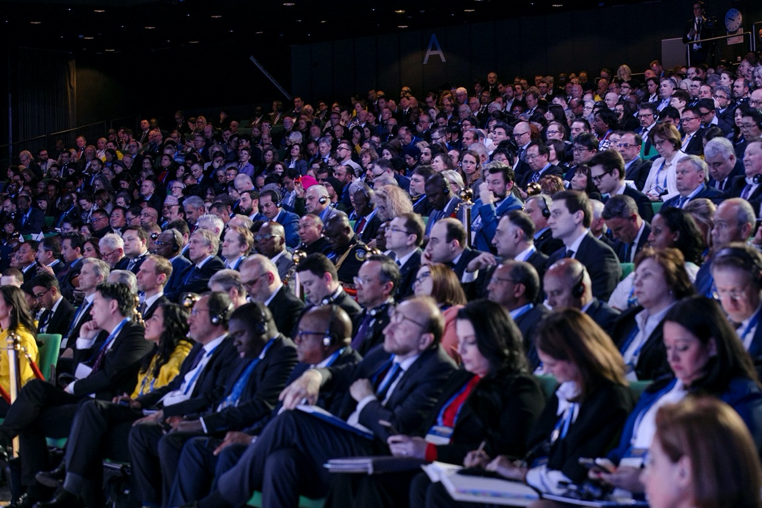

The week before when Europe understood the seriousness of corona
Notes:
Before I start….just A reflection from the photos taken during the conference……

Slide 5
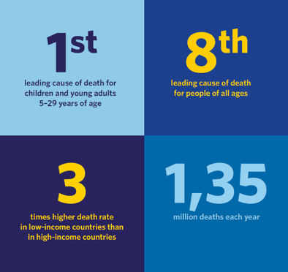
Every year there are 1.35 million road traffic fatalities globally.

Slide 6

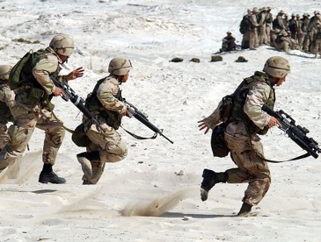
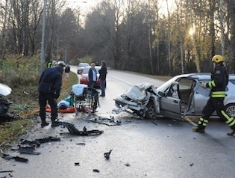
Global fatalities during 2000–2018
Weather and natural disasters
500 000
War and conflics
900 000
Road traffic
25 000 000
Children 0-14 year
2 million

Slide 8
Safe system approach
Assume that people make mistakes
Having safety as a boundary condition based on biomechanical tolerences for the human body
Best practice

Slide 9
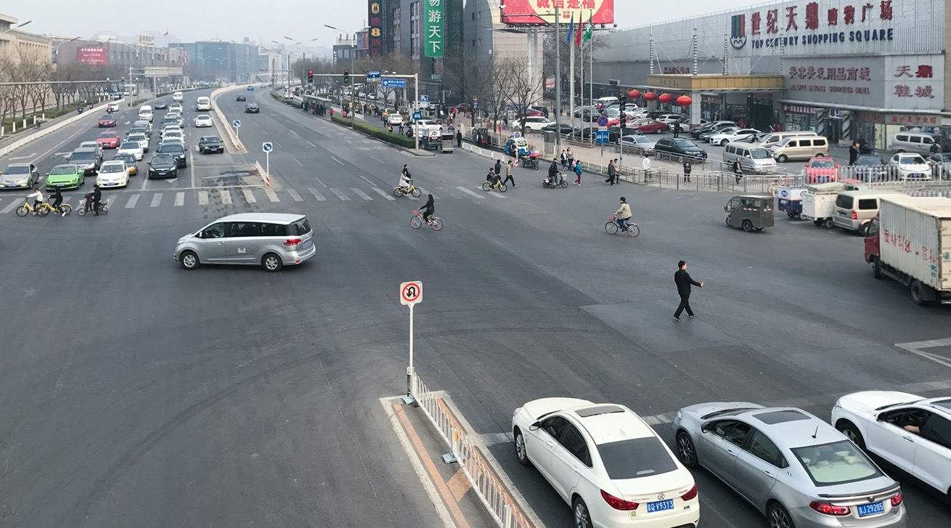


Slide 10
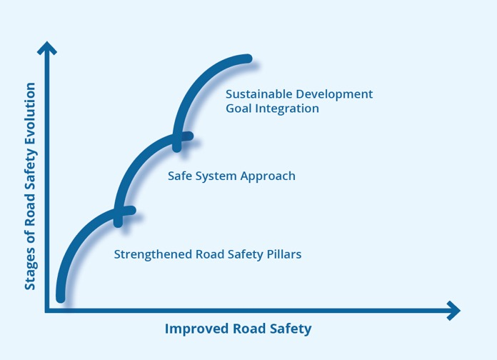
Evolution of the global road safety work

Slide 11

Road safety – part of a sustainable society
Climate change
Equality
Democracy
Health
Poverty
Human rights

Slide 12
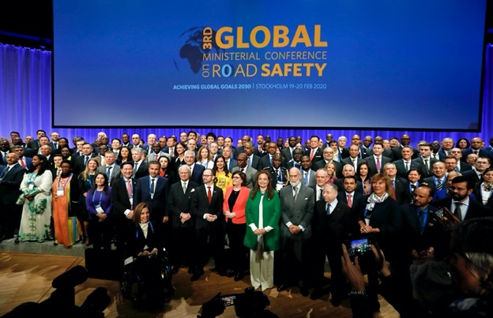
Stockholm declaration
Halved death rates are the Stockholm Declaration's target,
Recommendations from the Academic Expert Group,
Scientific assessments of progress made during the last decade.
More information: www.roadsafetysweden.com

Slide 13

Saving lives beyond 2020
– Recommendations from the international Academic Group
Sustainable Practices and Reporting
Procourment
Modal Shift
Child and youth health
30 km/h
Infrastructure
Safe vehicles across the globe
Zero speeding
Technology

Slide 14
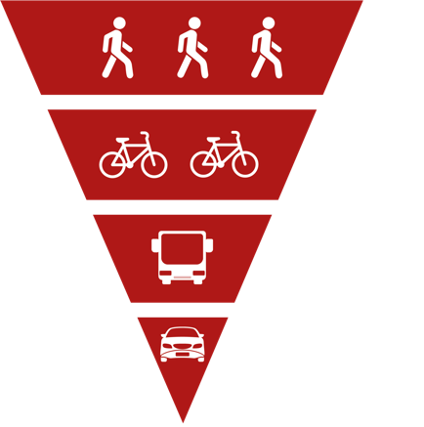
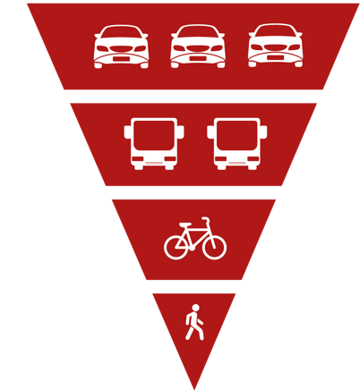
The traffic pyramid in cities

Slide 15
Modal shift
Ex challenge in Sweden
Healthy, clean air
Fossil free
Safe and secure
Mobility
Space and cost efficient

Slide 16
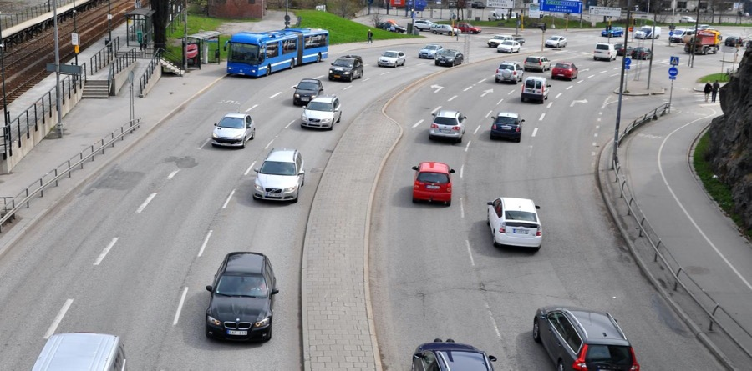
Traffic Safety footprints
Ex Challange in Sweden

Slide 17

RECOMMENDATIONS OF THE ACADEMIC EXPERT GROUP
FOR THE 3RD GLOBAL MINISTERIAL CONFERENCE ON ROAD SAFETY

Slide 18






”Health,
Climate and Equity”
”Public
procurement
is 10–20 % of
world GDP”
”The Goals
in SDG are
absolute and indivisible”
”Public and Private
Organisations
in Partnership”
”Sustainability
practices
and reporting”

Slide 19




Good Health and Well-being
By 2020, halve the number of global deaths and injuries from road traffic accidents.
Sustainable cities and communities
By 2030, provide access to safe, affordable, accessible and sustainable transport systems for all, improving road safety, notably by expanding public transport, with special attention to the needs of those in vulnerable situations, women, children, persons with disabilities and older persons.
Responsible consumption and production
Encourage companies, especially large and transnational companies, to adopt sustainable practices and to integrate sustainability information into their reporting cycle.
Promote public procurement practices that are sustainable,
in accordance with national policies and priorities.

Slide 20

#1 Sustainable Practices and Reporting
In order to ensure the sustainability of businesses and enterprises of all sizes, and contribute to achievement of a range of Sustainable Development Goals including those concerning climate, health, and equity, we recommend that these organizations provide annual public sustainability reports including road safety disclosures, and that these organizations require the highest level of road safety according to Safe System principles in their internal practices, in policies concerning the health and safety of their employees, and in the processes and policies of the full range of suppliers, distributors and partners throughout their value chain or production and distribution system.

Slide 21
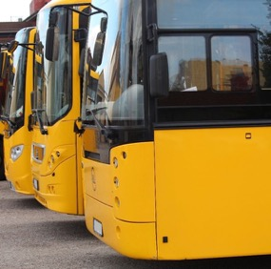
#2 Procurement
In order to achieve the Sustainable Development Goals addressing road safety, health, climate, equity and education, we recommend that all tiers of government and the private sector prioritize road safety following a Safe System approach in all decisions, including the specification of safety in their procurement of fleet vehicles and transport services, in requirements for safety in road infrastructure investments, and in policies that incentivize safe operation of public transit and commercial vehicles.

Slide 22
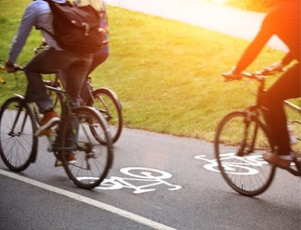
#3 Modal Shift
In order to achieve sustainability in global safety, health and environment, we recommend that nations and cities use urban and transport planning along with mobility policies to shift travel toward cleaner, safer and affordable modes incorporating higher levels of physical activity such as walking, bicycling and use of public transit.

Slide 23
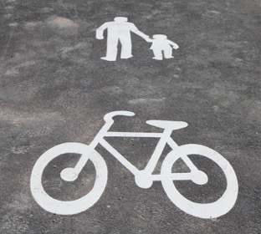
#4 Child and Youth health
In order to protect the lives, security and well-being of children and ensure the education and sustainability of future generations, we recommend that cities, road authorities and citizens examine the routes frequently traveled by children to attend school and for other purposes, identify needs, including changes that encourage active modes such as walking and cycling, and incorporate Safe System principles to eliminate risks along these routes.

Slide 24
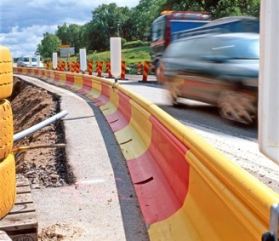
#5 Infrastructure
In order to realize the benefits that roadways designed according to the Safe System approach will bring to a broad range of Sustainable Development Goals as quickly and thoroughly as possible, we recommend that the governments and all road authorities allocate sufficient resources to upgrade existing road infrastructure to incorporate Safe System principles as soon as feasible.

Slide 25
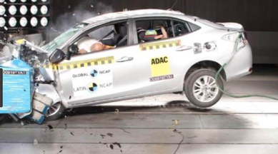
#6 Safe Vehicles across the Globe
In order to achieve higher and more equitable levels of road safety across the globe, we recommend that vehicle manufacturers, governments and fleet purchasers ensure that all vehicles produced for every market be equipped with recommended levels of safety performance, that incentives for use of vehicles with enhanced safety performance be provided where possible, and that the highest possible levels of vehicle safety performance be required for vehicles used in private and public vehicle fleets.

Slide 26
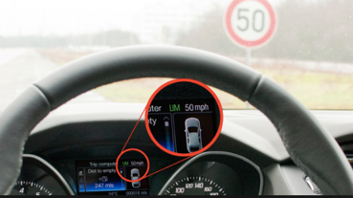
#7 Zero Speeding
In order to achieve widespread benefits to safety, health, equity, climate and quality of life, we recommend that businesses, governments and other fleet owners practice a zero-tolerance approach to speeding and that they collaborate with supporters of a range of Sustainable Development Goals on policies and practices to reduce speeds to levels that are consistent with Safe System principles using the full range of vehicle, infrastructure, and enforcement interventions.

Slide 27

#8 30 km/h
In order to protect vulnerable road users and achieve sustainability goals addressing livable cities, health and security, we recommend that cities mandate a maximum road travel speed limit of 30 km/h unless strong evidence exists that higher speeds are safe.

Slide 28

#9 Technology
In order to quickly and equitably realize the potential benefits of emerging technologies to road safety, including, but not limited to, sensory devices, connectivity methods and artificial intelligence, we recommend that corporations and governments incentivize the development, application and deployment of existing and future technologies to improve all aspects of road safety from crash prevention to emergency response and trauma care, with special attention given to the safety needs and social, economic and environmental conditions of low- and middle-income nations.

Slide 29
SOME KEY ACTIVITES FORWARD – SAFER PLATFORM
Where do we go from here?
Project proposal about the ”value-chain” (Recommendation #1 Sustainable Practices and Reporting) in preparation
2
Seminar-series, including dialogue about the nine recommendations during the autumn
3
Gap analysis: SAFER research activities vs the nine recommendations
4
Trafikverket to launch the research platform related to the SDG:s and the nine recommendations
1

Slide 30
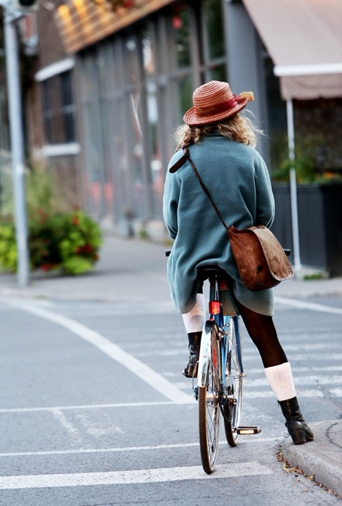
Research challenges and recommendations to the traffic safety research community
Your reflections and comments?

Slide 31

SUMMARY

Slide 32


MANY THANKS…
... for being part of the work to develop a joint strategy on how we in the research community together can utilize the opportunities that come with the UN Conference and the Stockholm Declaration!
We want to stay connected and will come back to you with more initiatives.
Do you have ideas or want to discuss? Or just bring in a comment? Most welcome to reach us at safer@chalmers.se or Magnus at
031-7726727, magnus.granstrom@chalmers.se

